Slide 1
Play That Track, Ross!
Presented by:
Charlie Nitschelm
Lucas Simmonds
Ross Thyne
Victor Lendaro
A Dynamics Project

Slide 2
The
Rube
Goldberg
Machine
START
59 grams
30 cm
15 cm
END
An Overview
215 cm

Slide 3
Step 1: Pendulum Release
A power cord hanging from the ceiling held back by a string is released at a given height above the collision point
Treated as a rigid body of uniform mass
The pendulum begins with potential energy with respect to its collision height, and ends with only kinetic energy before the collision with the tennis ball
Swing speed and traveling distance are measured and monitored during the test, respectively.

Slide 4
A small guide built out of plexiglass and pressure-treated lumber held together with tape and prayers
The guide is treated as perfectly rigid
The kinetic energy of the pendulum is transferred to the tennis ball through an inelastic collision. We are predicting a low coefficient of restitution (e).
The coefficient of restitution for the collision will be calculated from the actual measurements of the test
The impulse imparted on the ball from the wall can be calculated from the measured values of the test
The speed of the tennis ball after the impact and the total distance the ball travels
Step 2: Pendulum-Ball
Collision

Slide 5
Step 3: Play! That! Track!
A Ramp is used to transfer the ball from the wood block down to the switch of the record player.
The ball retains the kinetic energy from the pendulum collision while converting more potential energy into kinetic energy while rolling down the ramp minus the effects of friction.
The speed of the tennis ball after the impact and the total distance the ball travels is measured and monitored and measured during the test, respectively.

Slide 6
Conclusion A Conclusion
We measured the initial height of the pendulum and the velocity of the ball right before its impact with the record player. Using these known values we calculated the coefficient of restitution between the ball and the pendulum and the impulse that was imparted on the wall from the tennis ball.

Slide 7
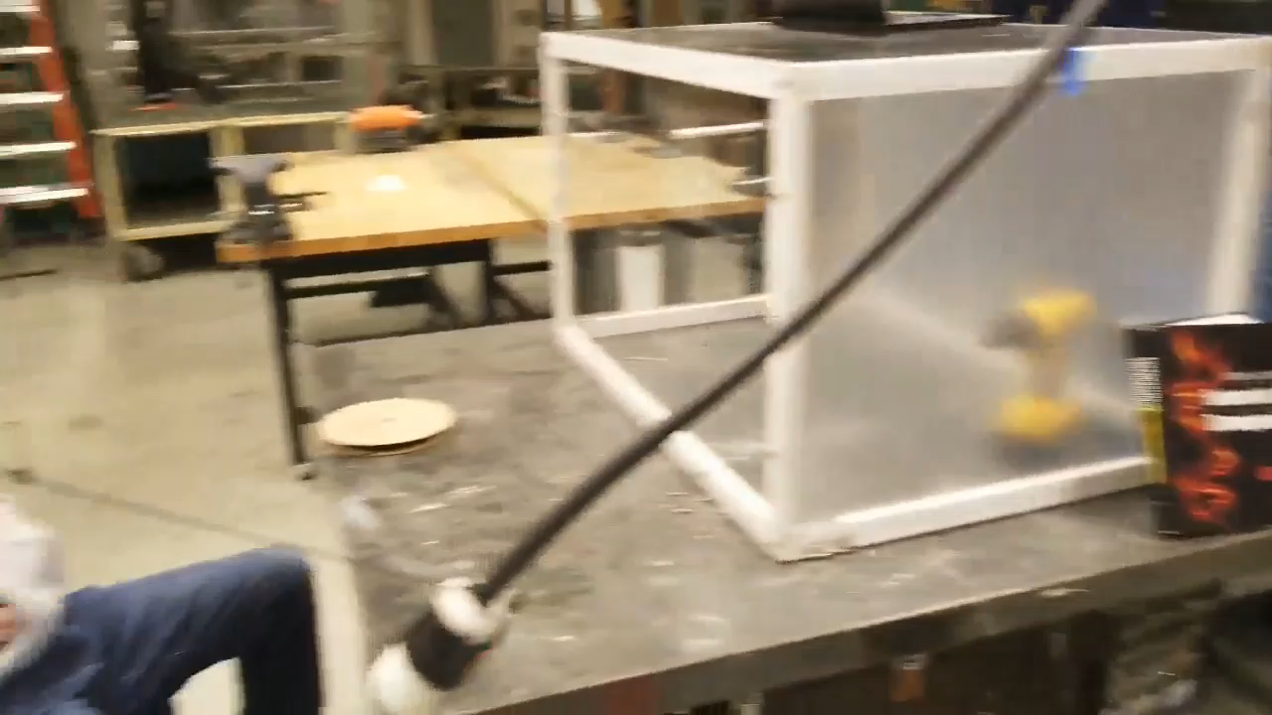
Play That Track, Ross!
A Video

Slide 8
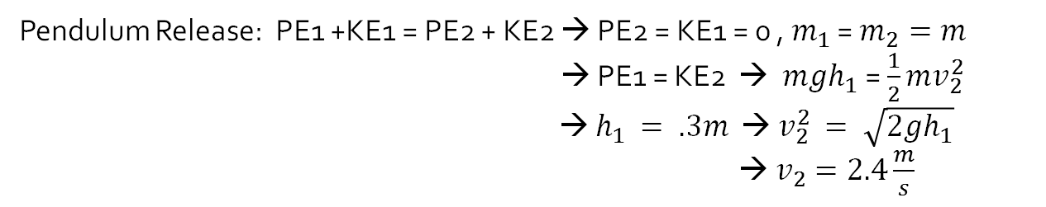
Analysis An Analysis
Pendulum Release: PE1 +KE1 = PE2 + KE2 → PE2 = KE1 = 0 , $m_{1}$ = $m_{2}=m$
→ PE1 = KE2 → $mgh_{1}$ = $\frac{1}{2}mv_{2}^{2}$
→ $h_{1 }= .3m$ → $v_{2}^{2 }= \sqrt{2gh_{1}}$
→ $v_{2}=2.4\frac{m}{s}$

